Slide 1
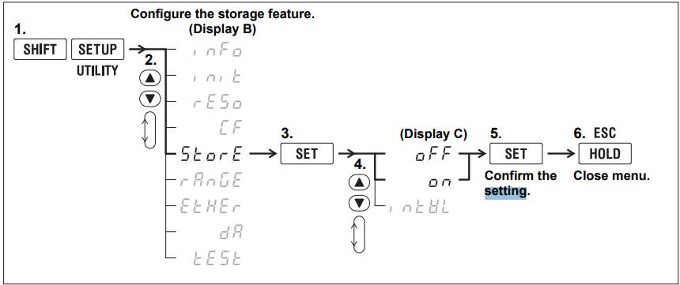
Station 2 Yokogawa IP address:
IP: 10.2.0.151
Subnet: 255.255.255.0
Gateway: 10.2.0.1
DHCP = OFF

